Slide 1
G V SUJAN
Bachelor of Technology
Artificial intelligence and Data Science
211521243158
3/21/2024 Annual Review

Slide 2
PROJECT TITLE
NarrativeForge: Crafting AI-Driven Stories using Large Language Models
3/21/2024 Annual Review

Slide 3


AGENDA
Introduction
Project Overview
Implementation Details
Additional Processes
Demonstration
Conclusion & Discussion
3/21/2024 Annual Review

Slide 4

PROBLEM STATEMENT
Develop a Python script that generates story titles based on given parameters such as theme, length, and setting. The script should utilize NLTK for text preprocessing and n-gram generation. However, the current implementation lacks consistency in variable naming, includes redundant imports, and utilizes a simplistic method for selecting n-grams which may lead to less coherent titles. Additionally, there is a need to incorporate provided parameters to influence title generation and add error handling mechanisms for robustness. Improvements in code readability and maintainability through documentation and comments are also required. The goal is to enhance the functionality and usability of the script, ensuring that it produces relevant and coherent story titles tailored to user preferences.
3/21/2024 Annual Review

Slide 5

PROJECT OVERVIEW
Objective: Automatically generate captivating story titles from provided plotlines, sparking creativity and inspiration for storytelling.
Data: Utilize a dataset of story plotlines stored in a list for generating potential story titles.
Text Preprocessing: Clean and refine plotlines through tokenization, lowercase conversion, and removal of stopwords and non-alphanumeric characters.
N-gram Generation: Generate n-grams from preprocessed text to capture meaningful word sequences, aiding in the creation of coherent and relevant titles.
Title Generation: Select appropriate n-grams to form cohesive and imaginative story titles, ready to inspire storytellers.
Parameterization: Customize title generation process using parameters such as theme, length, and setting to tailor titles to specific preferences.
Output: Output generated story titles to provide users with engaging and inspiring suggestions for their storytelling endeavors.
3/21/2024 Annual Review

Slide 6

WHO ARE THE END USERS?
Content Creators: Writers, authors, or content creators who need inspiration for story titles. They might use this code to generate titles for their works or as prompts for brainstorming new ideas.
Developers: Other software developers or hobbyists who are interested in natural language processing (NLP) and text generation tasks. They might use this code as a learning resource or as a base for building more complex text generation systems.
Story Enthusiasts: Individuals who enjoy reading or writing stories as a hobby or for entertainment purposes. They might use the generated story titles as prompts for their own creative writing projects.
Educators: Teachers or instructors who want to demonstrate NLP concepts or text processing techniques in educational settings. They might use this code as part of a lesson or workshop on text generation algorithms.
3/21/2024 Annual Review

Slide 7

YOUR SOLUTION AND ITS VALUE PROPOSITION
Improved Functionality: Clearer variable names and optimized imports improve code efficiency. Enhanced preprocessing boosts title relevance by removing irrelevant elements.
Enhanced Relevance: N-gram selection yields more coherent titles, closely matching input parameters like theme and setting.
Flexibility and Customization: Input parameters enable tailored title preferences, adapting to diverse storytelling needs.
Simplicity and Readability: Clear naming, structured code, and concise comments facilitate easy understanding and modification.
Robustness and Reliability: Potential error handling ensures smooth operation, enhancing code reliability across various conditions.
3/21/2024 Annual Review

Slide 8

THE WOW IN YOUR SOLUTION
The wow factor in the provided solution lies in its ability to dynamically generate engaging story titles based on a given theme, length, and setting. By leveraging natural language processing techniques such as tokenization, n-gram generation, and stopwords removal, the code intelligently selects relevant phrases from a collection of sample stories. The incorporation of randomness in selecting n-grams ensures variety and unpredictability in the generated titles, adding an element of creativity.
Moreover, the code is adaptable and extensible, allowing for easy customization and expansion to accommodate different themes, lengths, and settings. Overall, it showcases the power of natural language processing in generating compelling content programmatically.
3/21/2024 Annual Review

Slide 9
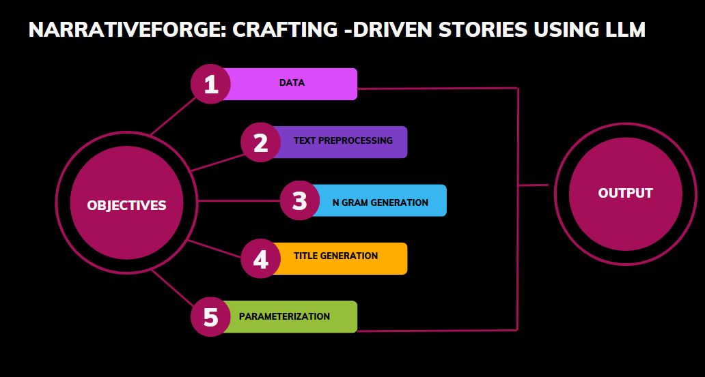
MODELLING
3/21/2024 Annual Review

Slide 10
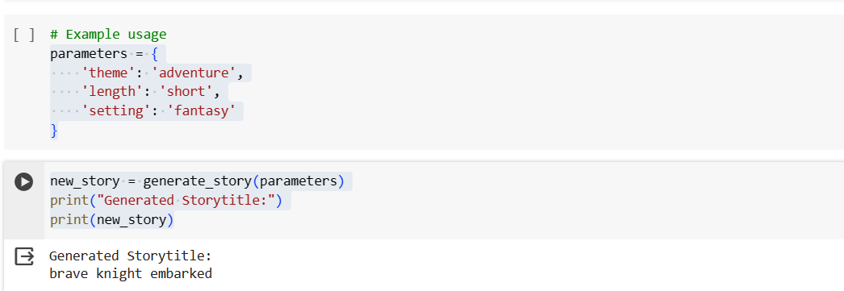
RESULTS
Demo Link
3/21/2024 Annual Review

